Slide 1

Apps Project
Samantha Lee

Slide 2
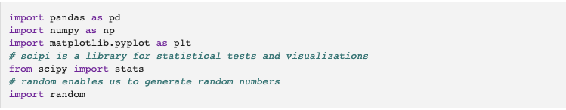
Libraries
Importing the libraries In this case we are going to import pandas, numpy, scipy, random and matplotlib.pyplot.

Slide 3
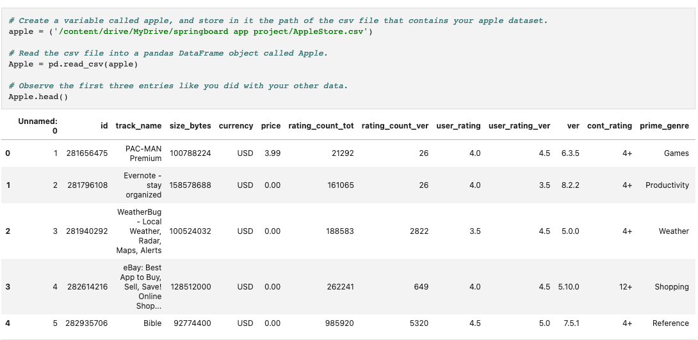
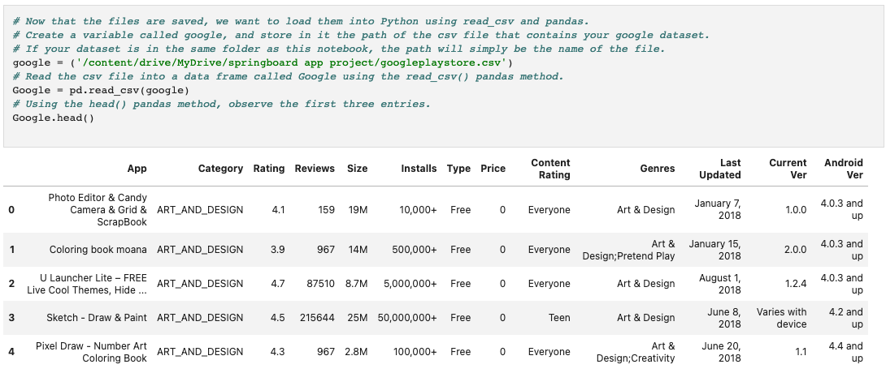
Storing and Sourcing Data
(Apple & Google)

Slide 4
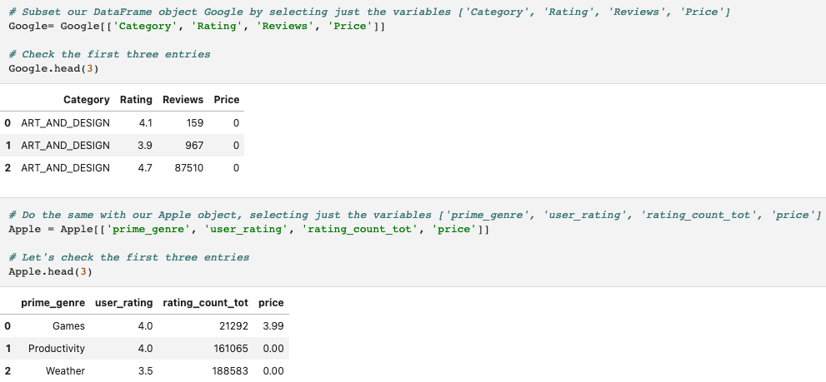
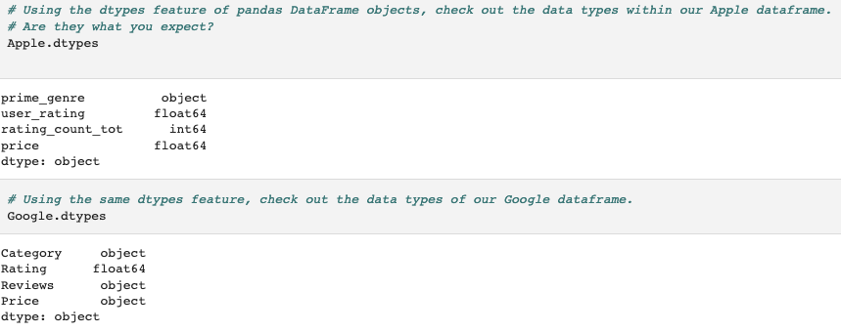
Chose the sections with which we will operate. We may infer from the documentation of these databases that the most suitable columns.
Selecting only those columns that we want to work with from both datasets.
Stage 2 consists of cleaning, changing, and transforming data. 2a. Check and correct the data categories for both Apple and Google. In Python, data types are critical for data analysis.

Slide 5
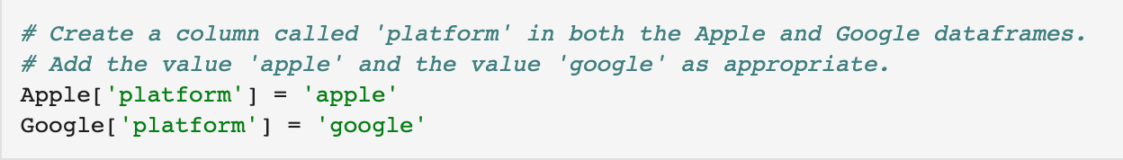
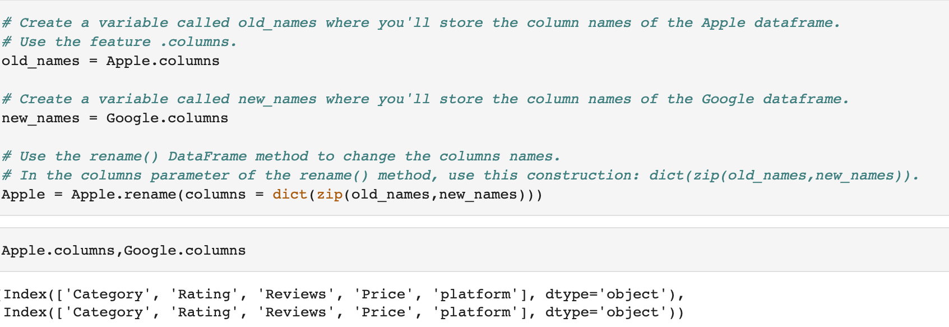
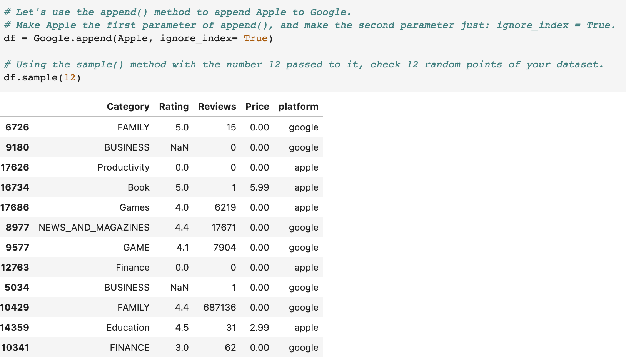
Changing the column titles to combine two datasets.
Alter the names of the Apple columns to the names of the Google columns.
Combine the two datasets into a single data frame called df.

Slide 6
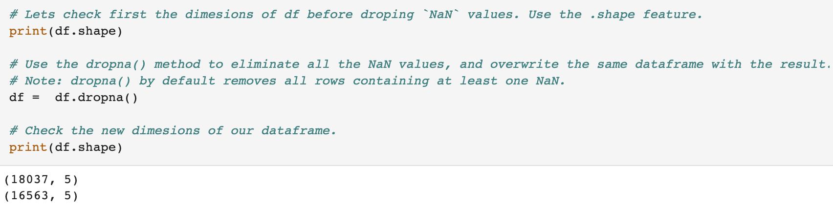
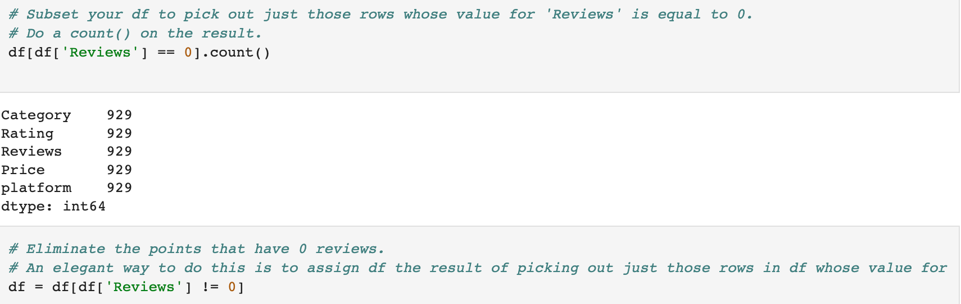
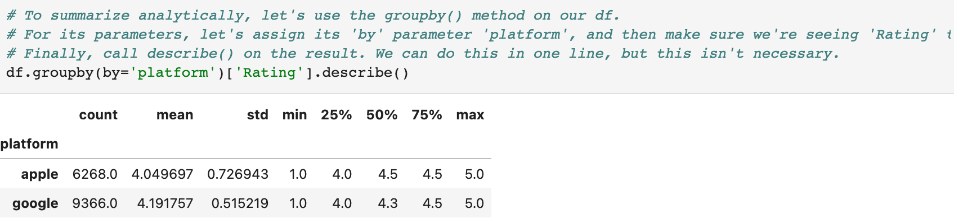
Remove the NaN numbers. There are some NaN numbers, as you can see. We want to remove all of the NaN numbers from the database.
Filter the data so that we only see apps that have been evaluated at least once. Apps that have not yet been reviewed cannot assist in solving our problem.
Our averages of 4.049697 and 4.191757. there's no discernible distinction between Google Play app ratings and Apple Store app reviews. We've noticed a change here: that is (4.191757 - 4.049697) = 0.14206

Slide 7
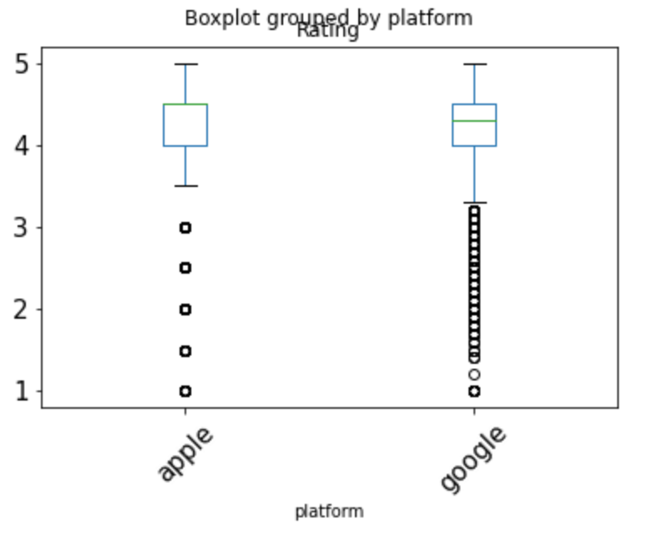
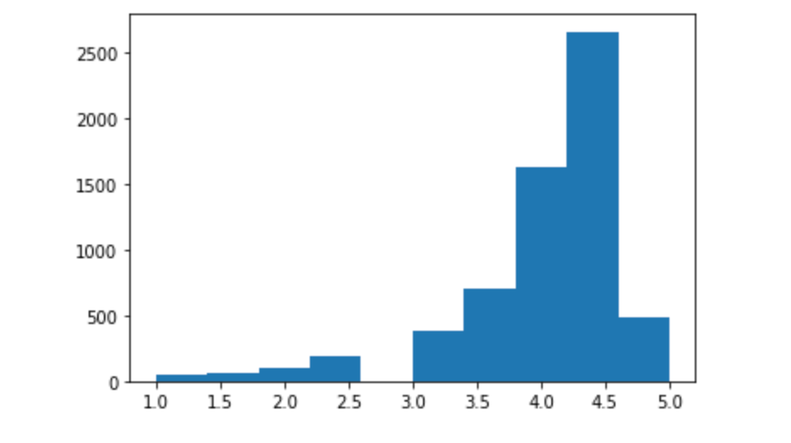
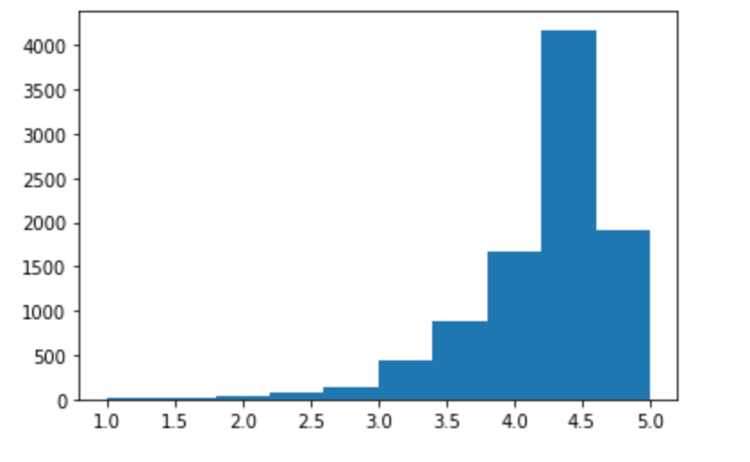
Modeling is the third stage of the process. 3a. Developing a Hypothesis Our Null premise simply states:
The noted disparity in the mean rating of Apple Store and Google Play applications is due to chance, according to Hnull. (thus, not due to the platform).
Alternative: the noticed disparity in average ratings between Apple and Google customers is not coincidental. (is due to platform)
We'll also choose an importance threshold of 0.05.
Because the p-values for both tests are 0 regardless of the significance threshold, we conclude that the data are not normally distributed.
A histogram can also be used to physically inspect the data spread. The following visible features characterize a normal distribution: - symmetric - unimodal (one curve) As well as a nearly similar mean, median, and mode.

Slide 8
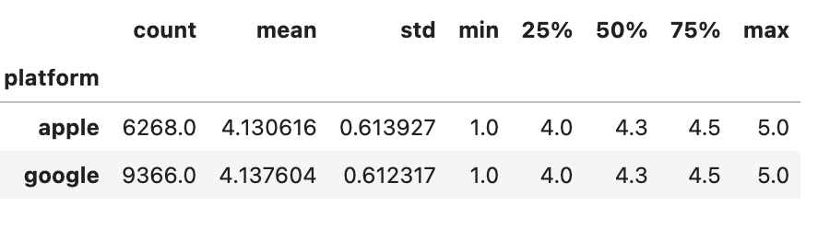
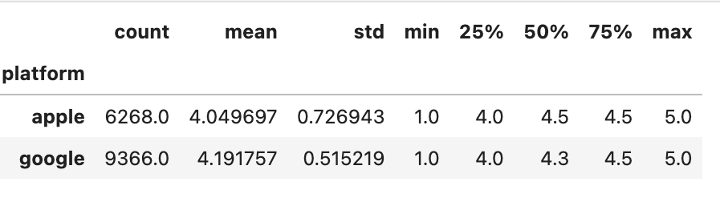
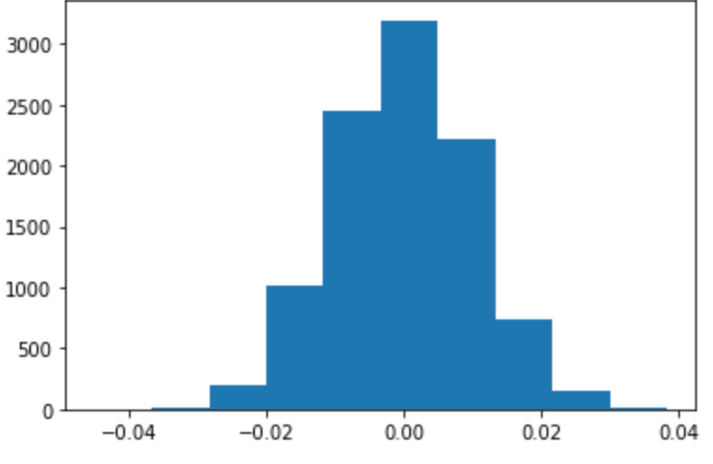
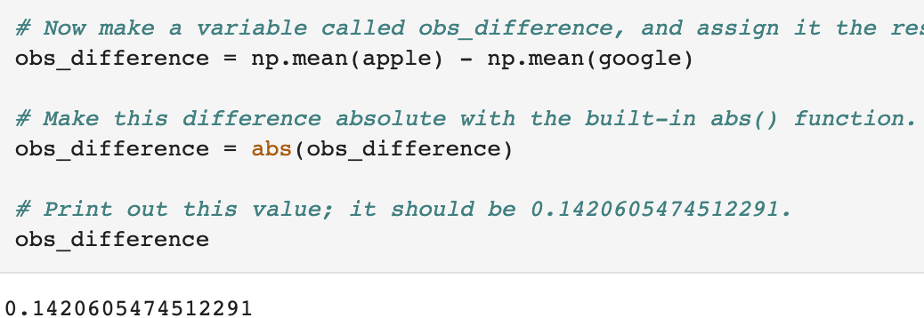
Conclusion
Used non-parametric test because the data aren't normally distributed. It is a statistical methods that are used when data is not normally distributed.
The difference in the means for Permutation (0.001103) now looks different to our observed difference of 0.14206.
P-value of our observed data is 0.
It doesn't matter which significance level we pick; our observed data is statistically significant, and we reject the Null.
We conclude that platform does impact on ratings. Specifically, we should advise our client to integrate only Google Play into their operating system interface.

